Slide 1


The Story of your ORS Abstract

Slide 2
Before submitting, check that you have:
Correct Title, Authors, Institution(s), Keywords
Introduction, Methods, Results, Discussion, Significance, Acknowledgements, References
Disclosures
Checked all necessary boxes

Slide 3
“You have successfully submitted an abstract!”
Make sure you get an online confirmation of your submission.

Slide 4
Your abstract is sent to four (4) ORS Reviewers to be scored.

Slide 5

Q: How many ORS reviewers are there??

Slide 6
Which reviewers will review
MY abstract??
Reviewers are assigned to review abstracts based on the first, second and third keywords selected during submission

Slide 7
TIP #1:
Be sure to select the “right” keywords and the order matters, so put the most relevant first.

Slide 8
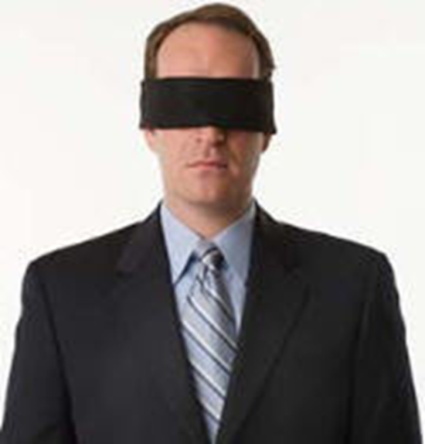
All abstracts go through a
“blinded” peer review process meaning = abstracts do not include author’s names, institution(s), references or acknowledgements
**Please note, although you may think they are, no reviewers are
actually blindfolded during the review process ☺

Slide 9

Q: What if there is a conflict?
E.g. if the reviewer is assigned an abstract from their lab, or they know whose work it is?
A: The abstract will get reassigned.

Slide 10
Q: How are abstracts scored?
1 = Superior (highest rank, exceptional)
Tip #2 : This is what to strive for!!!!

Slide 11
2 = Good (above average, highly recommended)
3= Acceptable (average rank)

Slide 12
4 = Marginal (second lowest, marginal consideration)
5 = Poor (lowest rank, not considered due to bias and/or scientific flaws)

Slide 13
After all 4 reviews have been received, the mean score is calculated.

Slide 14
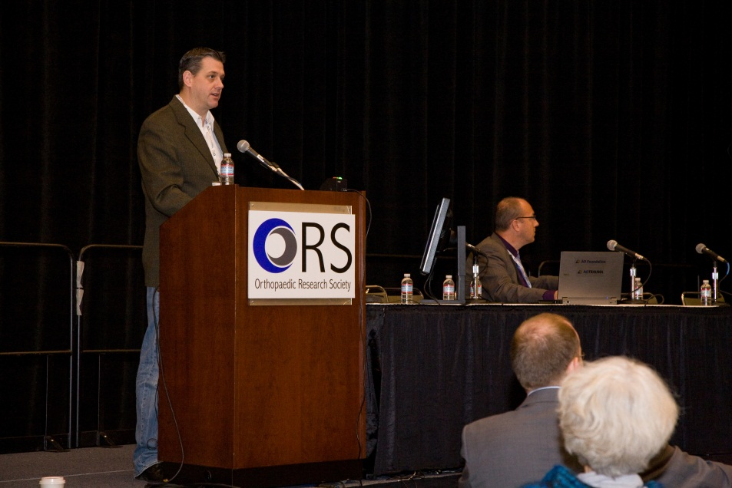
Now the Topic Chairs get to work:
They select the highest scored and most innovative abstracts and organize them into podium sessions.

Slide 15
Podium sessions are created from abstracts scoring
“1.0” to “2.0.”

Slide 16
Q: What happens if my abstract is accepted, but not as a podium presentation?

Slide 17
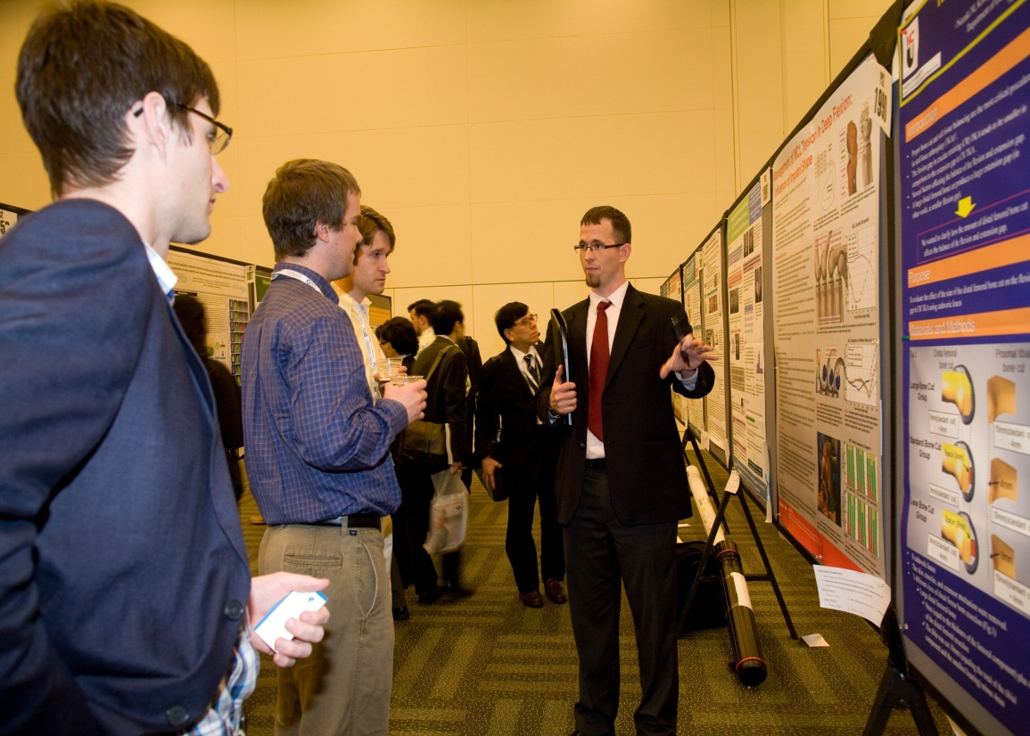
A: It is presented as a POSTER.

Slide 18
Program Meeting Day
The Program Committee meets for
2 days to review all suggested podium presentations and lays them out hour-by-hour, day-by-day.

Slide 19
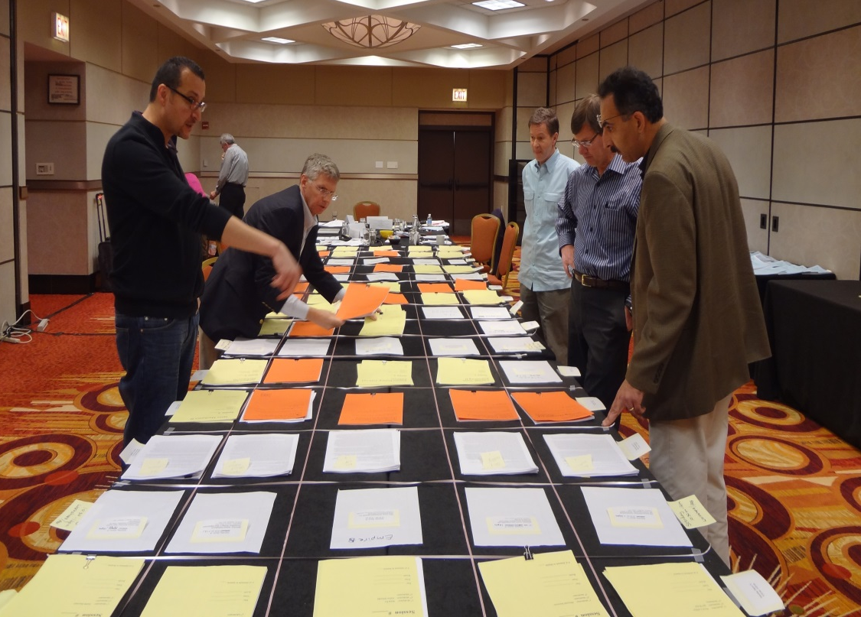
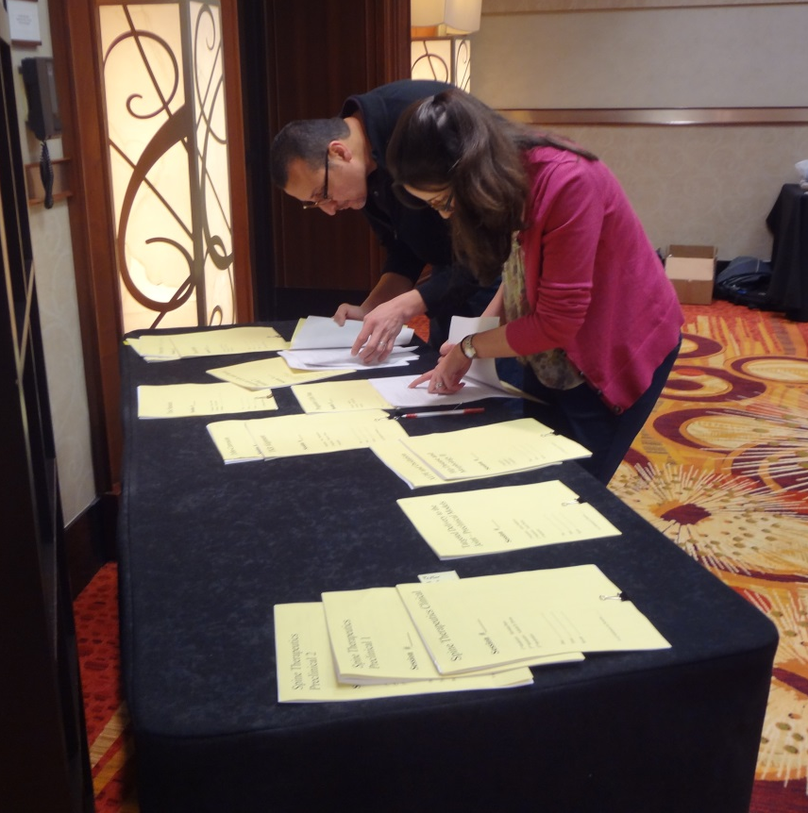

Slide 20
The committee also checks for multiple abstracts from the same group that are very similar, but happen to have different titles. These are either rejected or the group is asked to combine them.
Tip #3
Best to avoid this altogether.
The committee is pretty smart.

Slide 21
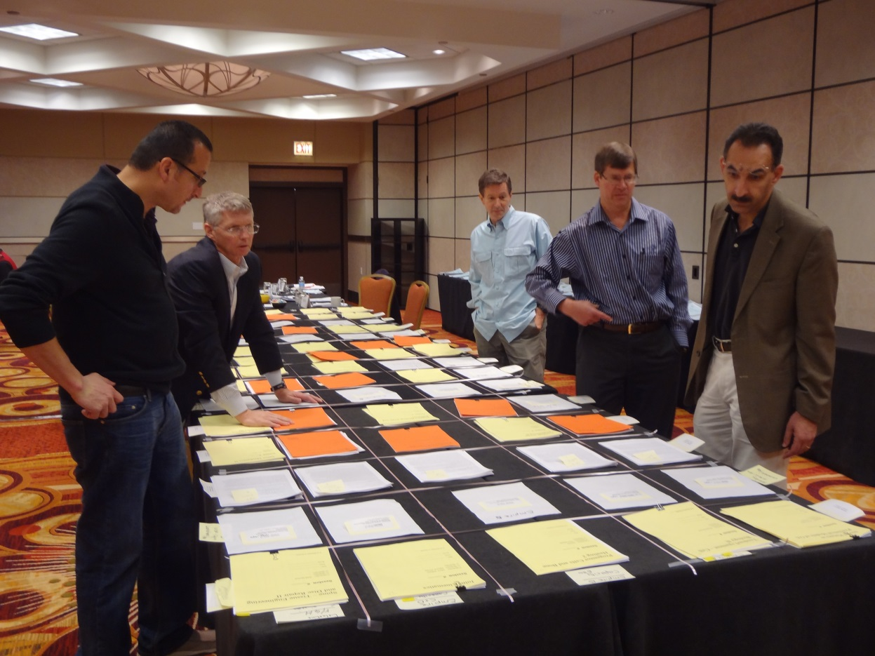
Finished!!

Slide 22
After the Program is finalized it is entered into our system.
The presenter is sent an acceptance ☺ or rejection ☹ notice. Co-authors are also sent a copy of the notice.

Slide 23



Slide 24

Tip #4 – If your abstract is rejected try again next year.

Slide 25
Tip #6
If your PRESENTER moves to another institution, or gets a new email address – be sure to inform us.

Slide 26
Tip #7
Register for the meeting!

Slide 27
Tip #8
If you are not a member of the ORS -
JOIN! http://www.ors.org/membership/

Slide 28
Thank you for submitting your abstract!

