Slide 1

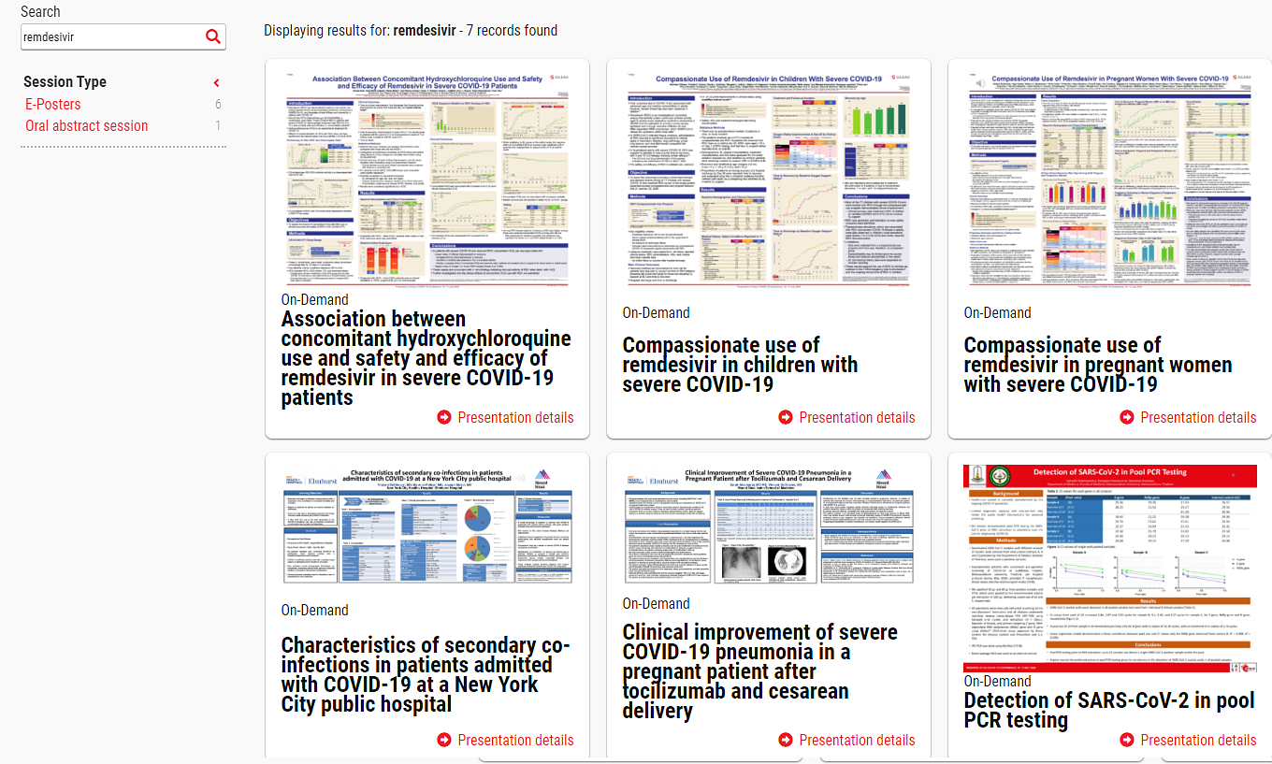
Posters

Slide 2

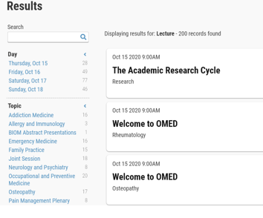
Posters
Sample with Abstract Details:
Text, Graphics, Video
Click to View ePoster
Sample Searchability:

